Slide 1
Introduction to HTML

Slide 2
Topics
HTML
  What is HTML
  Parts of an HTML Document
  HTML Tags

Slide 3
Hyper Text Markup Language
The language that is used to develop web pages is called Hyper Text Markup Language (HTML).
HTML is the language interpreted by the Browser.
Web pages are also called HTML document.
HTML is a set of special code that can be embedded in text to add formatting and linking information.
HTML is specified as Tags in an HTML document.

Slide 4
HTML
Used to create a Web page
Made up of tags that specify the structure of the document (this section is a heading, this section is a paragraph, etc..)
An extract from a sample HTML document:
<html>
<head>
<title> Web page</title>
</head>
<body>
<h1>This is my first Web page</h1>

Slide 5
HTML Tags
Tags are instructions that are embedded directly into text of the document .
An HTML tag is a signal to a Browser that it should do something.
By convention all HTML tags begin with an open angle bracket (<) and end with a close angle bracket (>).
HTML tags can be of two types
Paired Tags
Singular Tags

Slide 6
Paired Tags
A tag is said to be a pair tag if it along with a companion tag .For example the <B> tag is a paired tag .
The <B> tag with its companion tag </B> causes the text contained between them to be Bold.
The effect of the paired tag is applied only to the text they contain.
In paired tags , the first tag (<B>) is called opening tag and the second tag (</B>) is called closing tag.

Slide 7
Singular Tags
The second type of the tag is the Singular or Stand-alone tag.
A stand-alone tag does not have a companion tag.
For example <BR> tag will insert a line break . This tag does not require companion tag.

Slide 8
HTML Tags
Most HTML tags work in pairs. There is an opening and a closing tag. For example:
<p>Some content here.</p>
The <p>…</p> tag displays a paragraph
<p> opens the paragraph (opening tag)
</p> closes the paragraph (closing tag)
“Some content here.” will be displayed on the page

Slide 9
Self-closing/Singular Tags
Some HTML tags are self closing. For example:
<br>
The <br> tag will display a line break.

Slide 10
Required Tags
All HTML documents should have html, head and body tags.
  <html>…</html> -- Surrounds the contents of the entire page
  <head>…</head> -- Lists the identification information on the page, such as the title
  <title>…</title> -- Gives the name of the page that appears in the top of the browser window
  <body>…</body> -- Frames the content of the page to be displayed in the browser

Slide 11
Basic HTML Template
<html>
<head>
<title>CMSC104 HTML Template</title>
</head>
<body>
This is just a basic HTML template to be used in CMSC104.
</body>
</html>
Example file: template.html

Slide 12
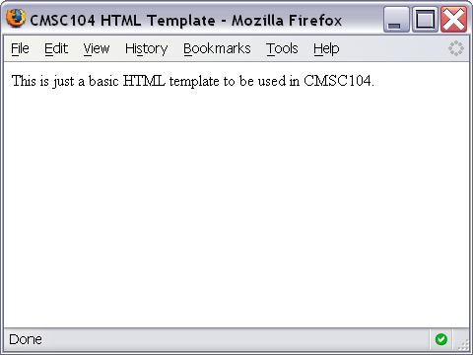
Basic HTML Template Screenshot

Slide 13
Attributes
The body tag takes the following attributes.
  BGCOLOR
  BACKGROUND
  TEXT ( To change the body text color)

Slide 14
TITLES AND FOOTERS
Title:
A web page could have a title that describes what the page is about . <Title> tag is used for this purpose. Text written b/w <Title> </Title> shows up in the title bar of browser window.

Slide 15
Some Common HTML Tags and Their Meanings
<p>…</p> -- Creates a paragraph
<br /> -- Adds a line break
<hr /> -- Separates sections with a horizontal rule
<h1>…</h1> -- Displays a heading (h1-h6)
<!--…--> -- Inserts a comment
<ol>…</ol> -- Creates an ordered list
<ul>…</ul> -- Creates an unordered list
<img /> -- Inserts an image into the document
<a>…</a> -- Inserts a link into the document

Slide 16
Paragraph Example
<p>
The exam next week will consist of T/F, multiple choice, short answer and pseudocode questions. You cannot use a calculator.
</p>
<p>
After the exam, we will learn JavaScript.
</p>

Slide 17
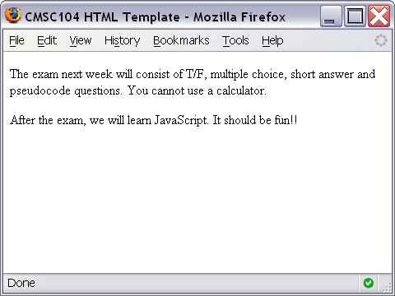
Paragraph Example Screenshot

Slide 18
Line Break Example
<p>
Roses are Red. <br />
Violets are Blue. <br />
You should study for Exam 1. <br />
It will be good for you!
</p>

Slide 19
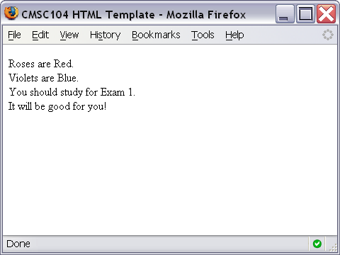
Line Break Example Screenshot

Slide 20
Horizontal Rule Example
<p>
The exam next week will consist of T/F, multiple choice, short answer and pseudocode questions. You cannot use a calculator.
</p>
<hr />
<p>
After the exam, we will learn JavaScript. It should be fun!!
</p>

Slide 21
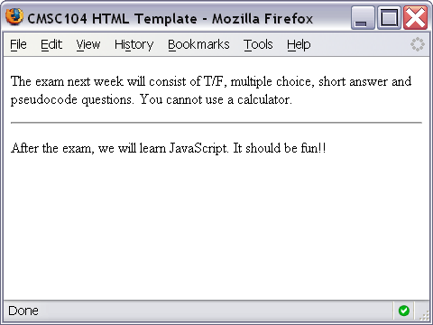
Horizontal Rule Example Screenshot

Slide 22
Heading Example
<h1>This is heading 1</h1>
<h2>This is heading 2</h2>
<h3>This is heading 3</h3>
<h4>This is heading 4</h4>
<h5>This is heading 5</h5>
<h6>This is heading 6</h6>

Slide 23
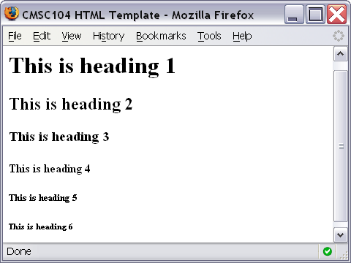
Heading Example Screenshot

Slide 24
Comment Example
<!-- This is just some sample html to illustrate the use of a comment -->
<p>
Here is my paragraph.
</p>
<!-- Here is another comment -->

Slide 25
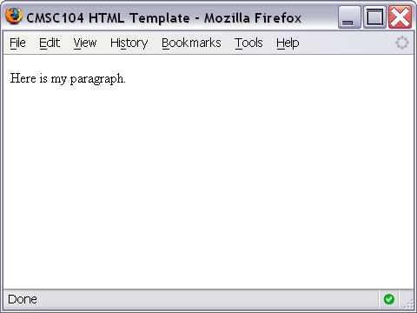
Heading Example Screenshot

Slide 26
HTML – Lists
Why lists are important:
They are widely used on links pages
They help in the organization of data
They are quick and easy to create

Slide 27
Order Lists (Numbering)
An order list start with the tags <OL> and ends with </OL>.
Each list item starts with the tag <LI>.
Attributes can be specified with <LI> tags.

Slide 28
Example
There are different types of Input devices
<oL Type =“1” Start=3>
<LI> Mouse
<LI>Keyboard
<LI> Joystick
</OL>

Slide 29
Ordered List Example
<ol>
<li>Print Review Questions for Exam1.</li>
<li>Work on Review Questions for Exam1.</li>
</ol>

Slide 30
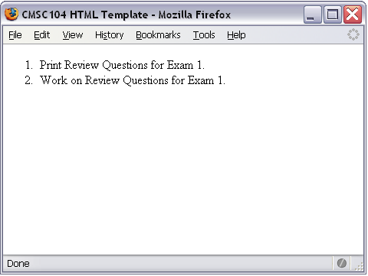
Ordered List Screenshot

Slide 31
Unordered Lists
An unordered list starts with <UL> tags and end with </UL>
Each list item tag start with <LI> tag.
  Attribute specified with <UL> tag is
  Type:
  Specify the type of the bullet. It can be
  FILL ROUND Or SQUARE.

Slide 32
Unordered List Example
<ul>
<li>country music</li>
<li>monday mornings</li>
<li>brussels sprouts</li>
</ul>

Slide 33
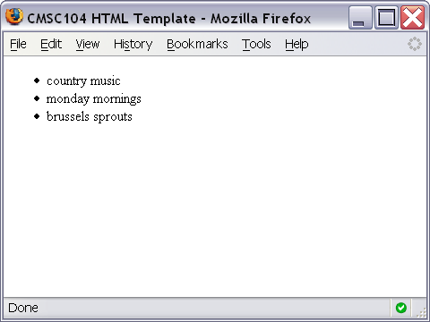
Unordered List Screenshot

Slide 34
Link Example
<a href="http://www.cs.umbc.edu/104/">CMSC104 Main page</a>

Slide 35
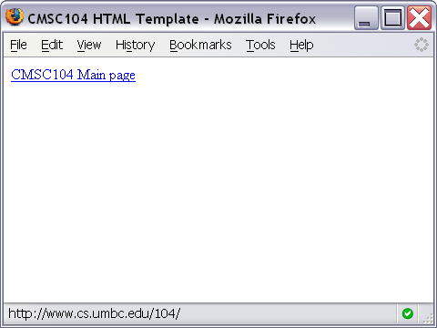
Link Screenshot

Slide 36
Adding Graphics To HTML
HTML allows to add static or animated images to an HTML Page.
HTML accepts pictures file formats i.e.
.gif and .jpg /. jpeg.
<IMG> tag is used to add the images.
This tag takes the image file as an attribute.

Slide 37
Image Example
<img src="linux-tux.png" alt="Tux the Penguin" />

Slide 38
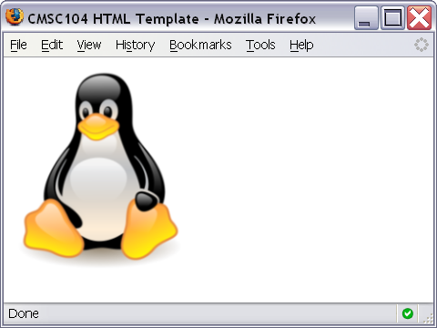
Image Screenshot

